Slide 1

ENERGY CONSUMPTION ANALYSIS
Name: D Veerabhadra Reddy
Batch No. 484

Slide 2
About Me
B-Tech, Computer Science Engineering
In today’s digital world, data is everywhere, and organizations rely on it to make smart decisions. Learning Data Analytics helps us turn raw data into meaningful insights.
LinkedIn: D Veerabhadra Reddy | LinkedIn
GitHub: veerabhadra212

Slide 3
Agenda
Business Problem
Problem Statement
Objectives
Table Description
ER Diagram
SQL Queries
Conclusion
Recommendations

Slide 4
Business Problem
Energy-economy gap in global policy decisions
The data silos problem: Raw energy data exists across multiple dimensions — consumption, production, emissions, population, and GDP — but remains siloed and unanalyzed.
The analytical gap: Without connecting these dimensions, policymakers cannot assess which nations drive global emissions, whether economic growth is decoupling from energy intensity, or how population growth amplifies environmental impact.
The consequence: Decisions on climate commitments, energy investment, and sustainability targets are made with incomplete evidence.

Slide 5
Problem Statement
Lack of structured insight into energy-emission-GDP interdependencies
The data dispersion problem: The EIA dataset captures global energy metrics across multiple countries and years, but the data is dispersed across six independent tables — country, emission, consumption, production, gdp_ppp, and population — with no pre-built analytical layer.
The unanswered questions: Without a unified view, key questions remain unresolved: Which economies emit the most relative to their GDP? Is consumption growing faster than production in emerging markets? Are per-capita emissions declining in major economies over time?
The strategic cost: Without structured SQL-based analysis that joins and aggregates these tables, energy planners and researchers cannot identify emission hotspots, track efficiency trends, or benchmark countries against global averages — leading to missed opportunities for data-driven climate and energy strategy.

Slide 6
Objectives
Identify the top and bottom performers in emissions, GDP, and energy consumption across all countries for the most recent year.
Quantify year-over-year changes in global and national emissions, GDP, and consumption to reveal acceleration or deceleration patterns.
Adjust raw totals by population to produce fair cross-country comparisons of energy use and emission intensity.
Compute emission-to-GDP and consumption-to-GDP ratios to determine how efficiently each economy converts energy use into economic output.
Measure the statistical relationship between GDP growth and energy production growth to test the decoupling hypothesis.

Slide 7
Table Description
There are 6 tables in Energy Consumption Analysis. They are
Country Table
Emission Table
Population Table
Production Table
GDP Table
Consumption Table

Slide 8
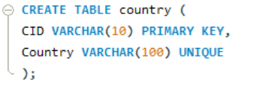

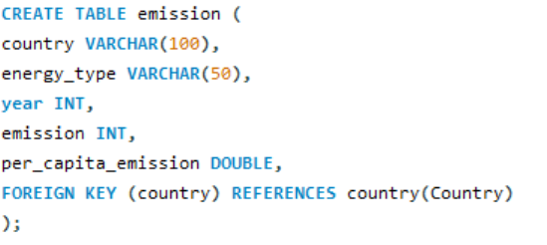
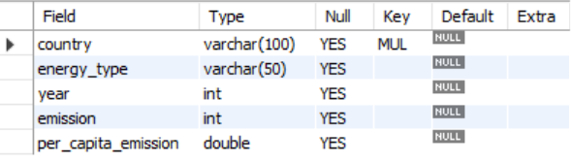
Country Table
Emission Table

Slide 9
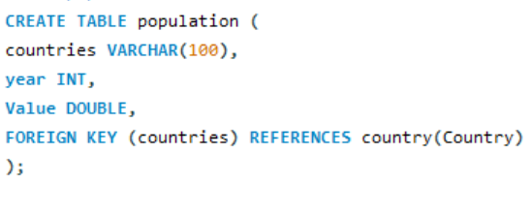
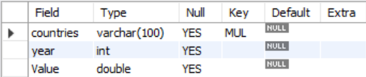
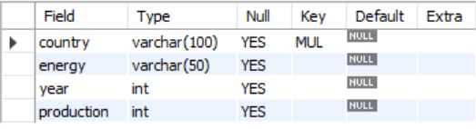
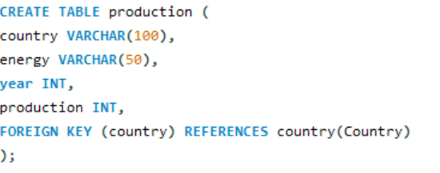
Population Table
Production Table

Slide 10
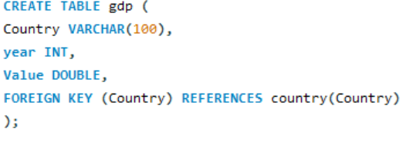
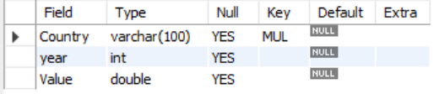
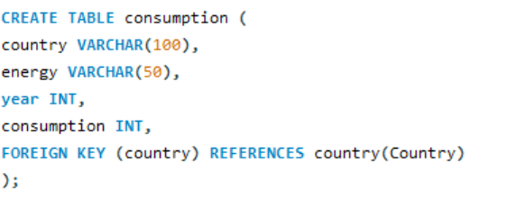
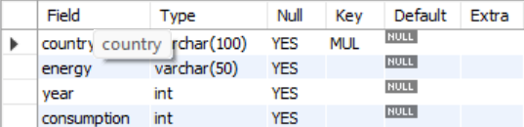
GDP Table
Consumption Table

Slide 11
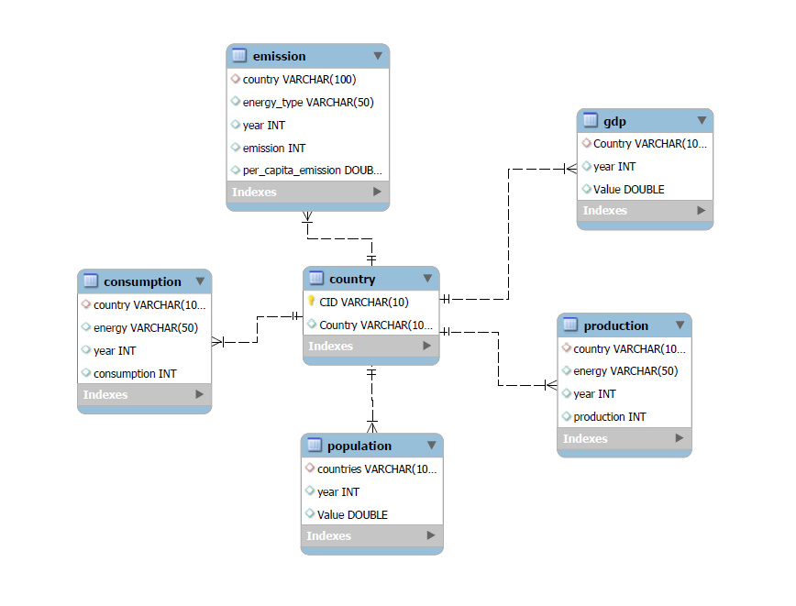
ER Diagram

Slide 12
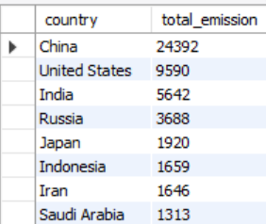
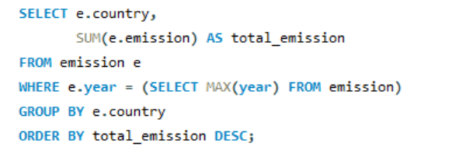
What is the total emission per country for the most recent year available?

Slide 13
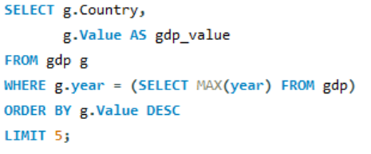
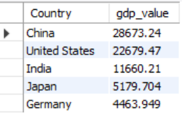
What are the top 5 countries by GDP in the most recent year?

Slide 14
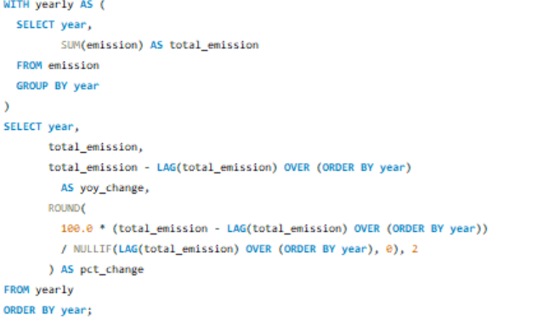
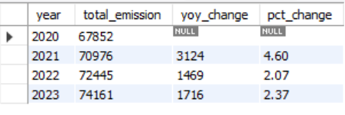
How have global emissions changed year over year?

Slide 15
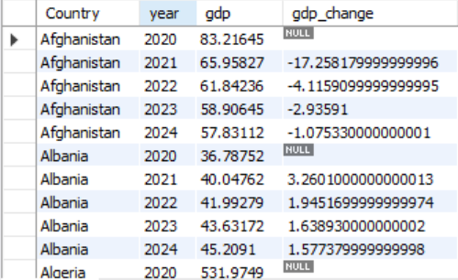
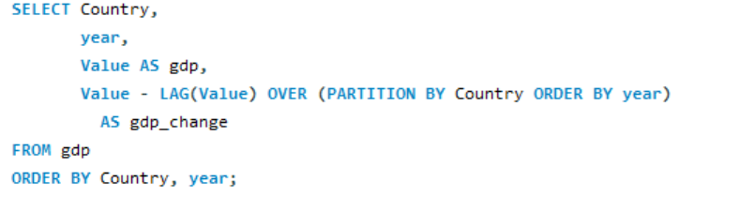
What is the trend in GDP for each country over the given years?

Slide 16
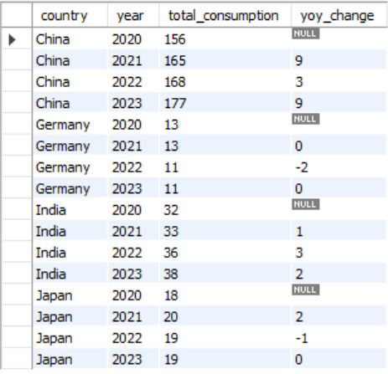
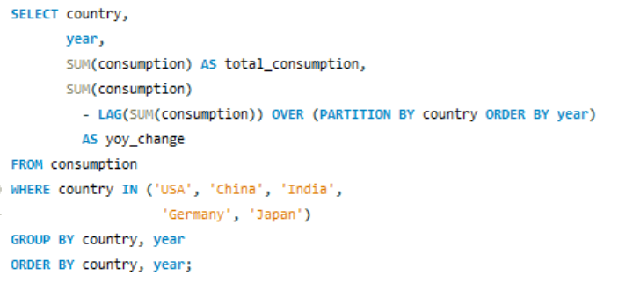
Has energy consumption increased or decreased over the years for major economies?

Slide 17
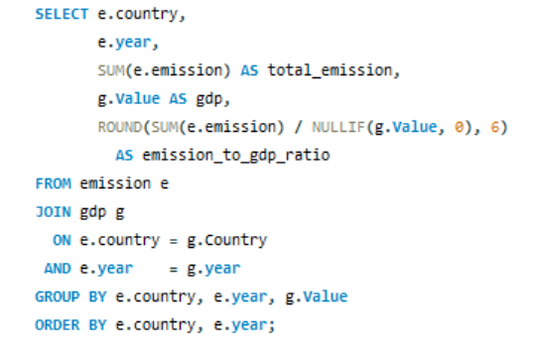
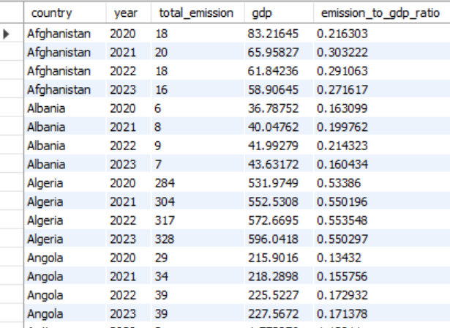
What is the emission-to-GDP ratio for each country by year?

Slide 18
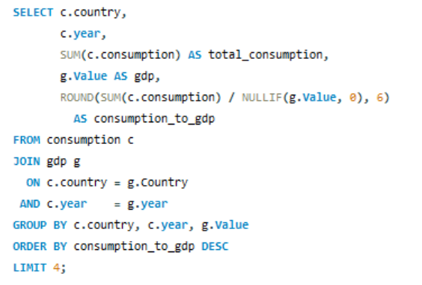
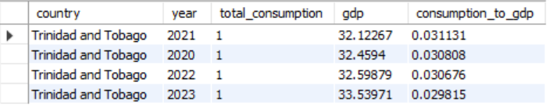
Which country has the highest energy consumption relative to GDP?

Slide 19
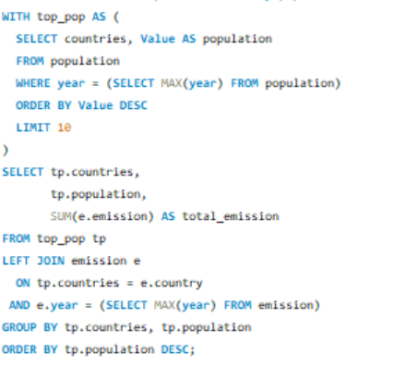
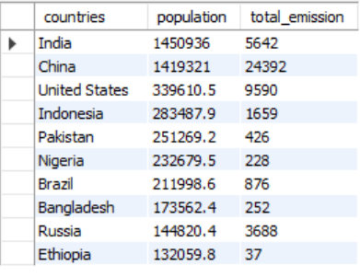
What are the top 10 countries by population and how do their emissions compare?

Slide 20
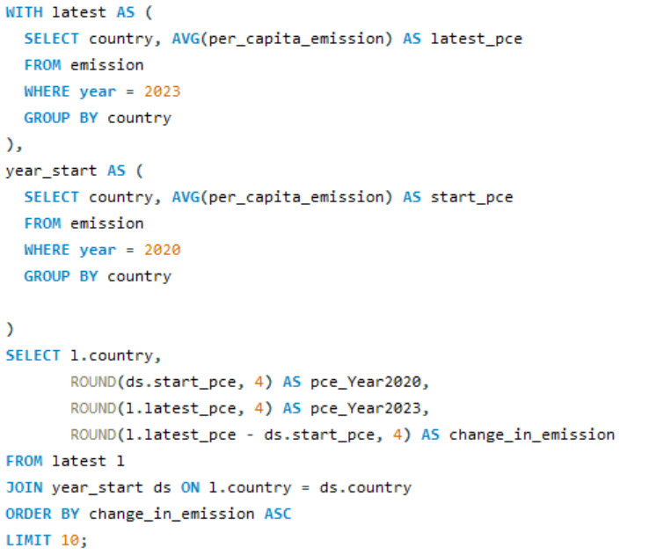
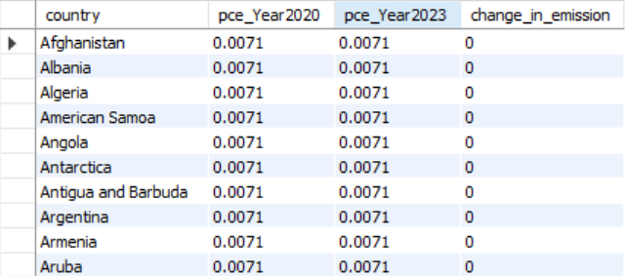
Which top 10 countries have improved (reduced) their per capita emissions the most over the time?

Slide 21
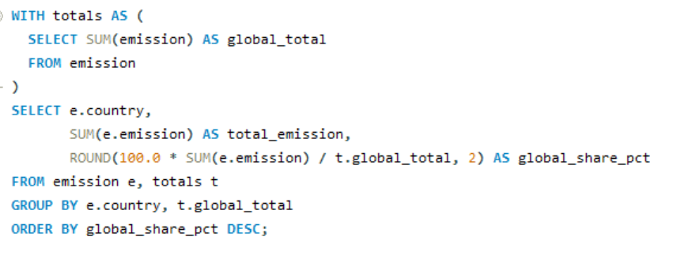
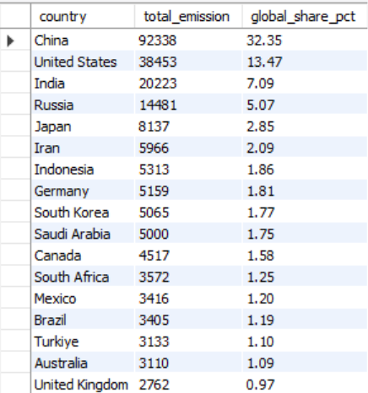
What is the global share (%) of emissions by country?

Slide 22
Conclusion
The core insight: Energy data, when structured relationally and queried with intent, becomes a powerful lens for understanding the intersection of economic development, population growth, and environmental responsibility.
The approach: By working across six interconnected tables — country, emission, consumption, production, gdp_ppp, and population — the analysis moved beyond isolated numbers.

Slide 23
Recommendations
Enrich the data covers what new data sources to bring in (renewables, trade flows, sub-national data) to make the existing schema more powerful without changing the analytical approach.
Deepen the analysis moves beyond SQL into forecasting and machine learning showing evaluators that you understand where data analysis naturally leads.
Communicate and act ties the technical work to real-world impact dashboards, policy alignment with the UN SDGs, and live data feeds which demonstrates genuine strategic thinking.

Slide 24


Slide 25

THANK YOU

